Slide 1

CHILD ABUSE
Name
Instructors Name
Course
Date

Slide 2
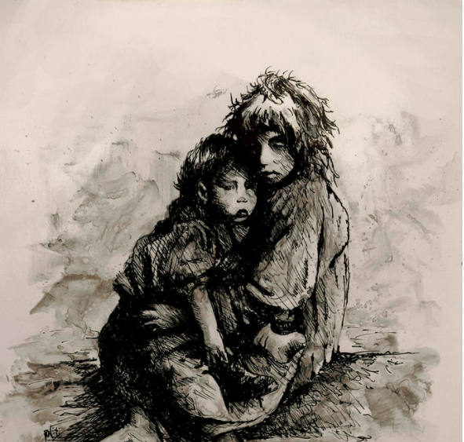
Rachel Christine Nowicki

Slide 3
Nowicki’s Artistic Work
Rachel is a professional artist with over 20 years experience.
She has a wide range of experiences as an artist
  museum display artist
  sculptor
  illustrator
  a graphic artist
  a technical illustrator
  a photographer
  Her artist picture describe abused , homeless and neglected children
  It Reveals the state of hopelessness and despair resulting from child abuse and neglect

Slide 4
Statistics
Millions of children are abused and neglected every year (UNICEF, 2016)
In America alone, over 20,000 children have been killed by family members in the past 10 years (Burrows Connie, and Tracy 1).
Globally, 1 billion children aged 2–17 years experienced physical, sexual, emotional or multiple types of violence.
One in five women and one in 13 men report having been sexually abused as a child.
Yearly, 41,000 homicide deaths in children under 15 years of age results from Child Abuse

Slide 5
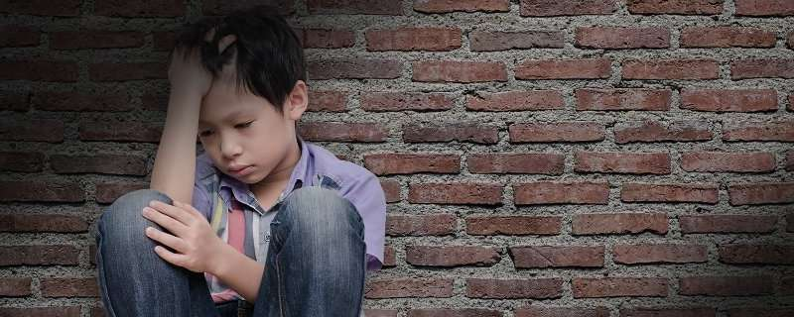
Effect of Child Abuse
Improper brain development
Lower language development
Blindness, cerebral palsy from head trauma
Impaired cognitive (learning ability) and socio-emotional (social and emotional) skills (Boykin 7)
Smoking, alcoholism and drug abuse
Psychological and behavioral disorder
post-traumatic stress disorder

Slide 6
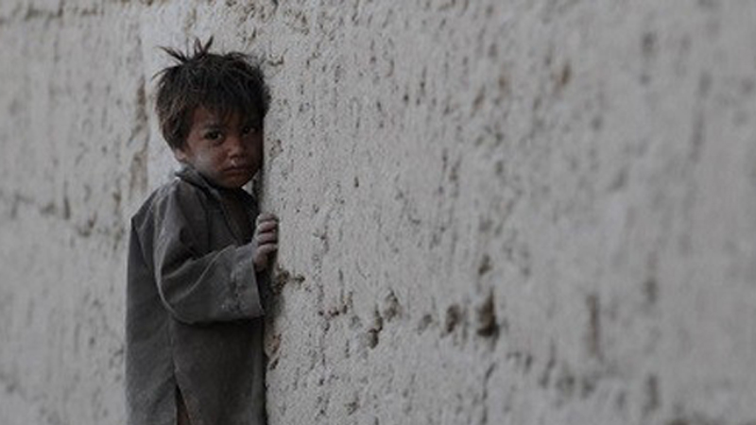
CAUSE OF CHILD ABUSE

Slide 7
Causes
Poor parental Care(Smith and Rowena 145)
Parental immaturity
Marital problems
Unemployment
Alcohol and drug abuse (Al Odhayani 832)
Poverty
Unemployment

Slide 8
Works Cited
Boykin, Derricka M., et al. "Barriers to self-compassion for female survivors of childhood maltreatment: The roles of fear of self-compassion and psychological inflexibility." Child Abuse & Neglect. EBSCO eBook Collection, 0-eds.b.ebscohost.com.wave.lccc.edu/ehost/detail detail?vid=3&sid=281a37bf-d925-4e94-9e6a c231803b98d2%40sessionmgr102&bdata=JkF1dGhUeXBlPWlwLGNvb2tpZSx1cmwsdWlkJnNpdGU9ZWhvc3QtbGl2ZQ%3d%3d#AN=127285766&db=a9h. Accessed 28 Feb. 2018.
Burrows-Horton, Connie, and Tracy K. Cruise. Child Abuse and Neglect. New York City, Guildford Press, 2001. EBSCO eBook Collection books.google.com/books?id=v3LzmLUVwgAC&printsec=frontcover&source=gbs_ViewAPI# =onepage&q&f=false. Accessed 26 Feb. 2018.
Janagan-Johnson, Emmanual, and Christine James. "Effects of child abuse and neglect on adult survivors." Early Child Development & Care. EbscoHOST, 0 eds.b.ebscohost.com.wave.lccc.edu/ehost/detail/ detail?vid=3&sid=86f61c3d-e93e-4879-bc97-f9df2add6754%40sessionmgr104&bdata=JkF1dGhUeXBlPWlwLGNvb2tpZSx1cmwsdWlkJnNpdGU9ZWhvc3QtbGl2ZQ%3d%3d#AN=118732748&db=a9h. Accessed 23 Feb. 2018.
S., Ruth, and C. Henry Kempe. Child Abuse. Edited by Jermone Bruner et al., Cambridge, Harvard UP, 1978. EBSCO eBook Collection, books.google.com/books?id=XZ6B-ygMMLoC&printsec=frontcover&source=gbs_ViewAPI#v=onepage&q&f=false. Accessed 26 Feb. 2018
Global Statistics on Children’s Protection from Violence, Exploitation and Abuse - UNICEF DATA. (2018). UNICEF DATA. Retrieved 14 March 2018, from https://data.unicef.org/resources/global-statistics-childrens-protection-violence-exploitation-abuse/
Smith, Margaret G., and Rowena Fong. The children of neglect: When no one cares. Psychology Press, 2004.
Al Odhayani, Abdulaziz, William J. Watson, and Lindsay Watson. "Behavioural consequences of child abuse." Canadian family physician 59.8 (2013): 831-836.

